Slide 1
Chapter 8.2
Reviews

Slide 2
Chapter 8.2 - Reviews
Continuing…
Peer reviews (Inspections and Walkthroughs)
  Participants
  Preparations
  The FDR session
  Post-review activities
  Peer review coverage
Comparison of peer reviews methods
Expert opinions

Slide 3
Peer Reviews
Will discuss
  1. inspections and
  2. walkthroughs.
Difference between formal design reviews and peer reviews is really in both their participants and authority.
DRs: most participants hold superior positions to the project leaders and customer reps;
Peer reviews, we have equals
  members of his/her department and other units.

Slide 4
Peer Reviews
Other major difference is
  degree of authority and
  objective of each review method.
FDRs: authorized to approved design doc
  work can now continue in project.
Not granted in peer reviews
  main objectives lie in
    detecting errors and
    deviations from standards.

Slide 5
Participants of Peer Reviews
Inspection
Walkthrough
Review leader
The author
Specialized professionals:
  Designer
  Coder or implementer
  Tester
Review leader
The author
Specialized professionals:
  Standards enforcer
  Maintenance expert
  User representative

Slide 6
Peer Reviews - more
Tendency nowadays: diminish the value of manual reviews such as inspections and reviews.
We don't have as many as we used to.
Largely due to agile approaches to development and concerns for time savings and streamlining the process wherever possible.
Empirical evidence, however, indicates convincing evidence that peer reviews are highly efficient and effective.

Slide 7
Peer Reviews:
Inspections / Walk-Throughs
Walkthroughs and inspection differ in formality –
Inspections emphasize the objective of corrective action; more formal
Walkthroughs limited to comments on document reviewed.
Inspections also look to improve methods as well.
Inspections are considered to contribute more to general level of SQA.

Slide 8
Peer Reviews: Inspections
Inspections usually based on a comprehensive infrastructure:
  Development of inspection checklists for each type of design document as well as coding languages, which are periodically updated.
  Development of typical defect type frequency tables, based on past findings to direct inspectors to potential ‘defect concentration areas.’
  Training of competent professionals in inspection process issues – making it possible for them to serve as inspection leaders (moderators) or inspection team members
  Periodic analysis of the effectiveness of past inspections to improve the inspection methodology
  Introduction of scheduled inspections into project activity plan and allocation of the required resources, including resources for corrections

Slide 9
Comparing the Two…
Organizations typically modify methods to local considerations.
Local protocols, team structure, etc. can be modified.
So, differences between the two can be easily blurred.
Some view one as the other; vice versa
Some argue that one is better than the other, and vice versa.
Research has indicated that walkthroughs discover far fewer defects found but at the same cost.
Likely this is due to some of the lost formalisms??

Slide 10
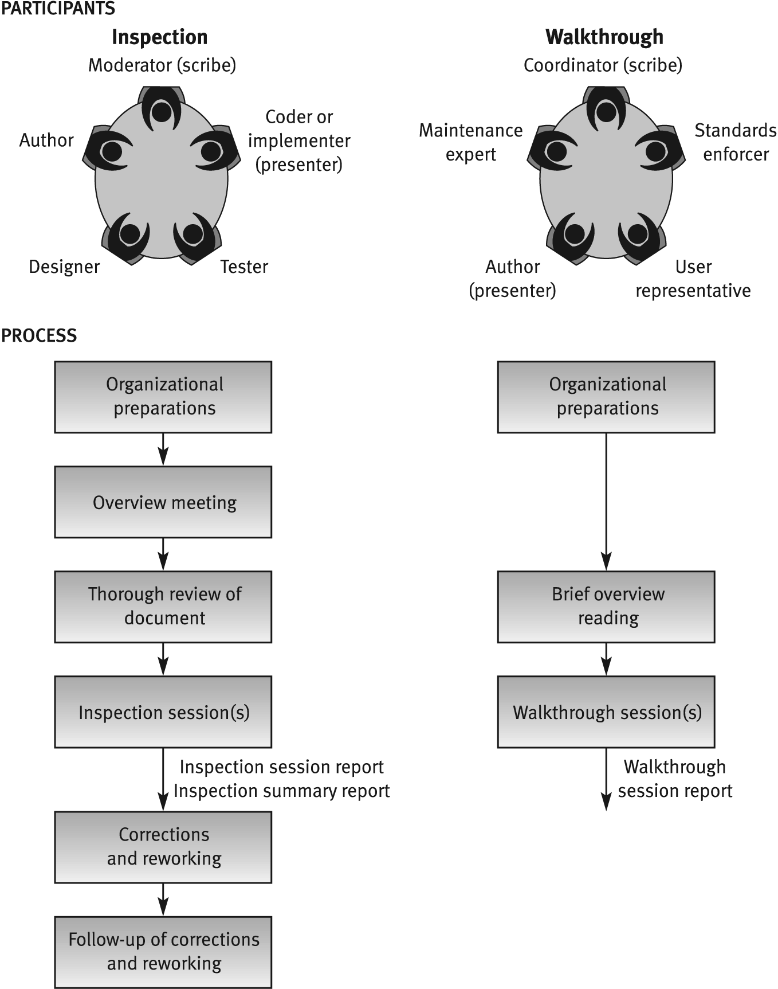
Inspection vs. Walkthrough
Note: author is
not the presenter
Much less
formal…
Author is the
presenter

Slide 11
Focus on Peer Reviews:
So for these two peer review methods, we will look at:
  Participants of peer reviews
  Preparation for peer reviews (some major differences)
  The peer review session (presenters and emphases are different)
  Post peer-review activities (differ considerably)
  Peer review efficiency (arguable)
The principles that we talk about can apply to both design peer reviews and code peer reviews.

Slide 12
Participants of Peer Reviews
Optimally, 3-4 participants
Should be peers of the software system designer-author.
  This allows for free discussion without any intimidation.
Need a good blend of individual types: a review leader, the author, and specialized professionals as needed for the focus of the review.
Review Leader
  Moderator in inspections; Coordinator in walkthroughs.
  Must be well-versed in project development and current technologies
  Have good relationships with author and development team
  Come from outside the project team
  History of proven experience in coordination / leadership settings like this.
  For inspections, training as a moderator is required.

Slide 13
Participants of Peer Reviews
Specialized Professionals – note these are experienced folks.
These differ by review type: inspections / walkthroughs
Inspections: (Walk-throughs - next slide)
  A designer – generally the systems analyst responsible for analysis and design of software system reviewed
  A coder or implementer – one who is thoroughly acquainted with coding tasks, preferably the leader of the designated coding team.
    Able to detect defects leading to coding errors and other software implementation issues.
  A tester – experienced professional, preferably leader of assigned testing team who focuses on identification of design errors usually detected during the testing phase.

Slide 14
Participants of Peer Reviews
Specialized Professionals differ by review type : walkthroughs
Walk Throughs:
  A standards enforcer – team member specialized in development standards and procedures;
    locate deviations from these standards and procedures. (coding standards, such as indentation, data naming, program organization, such as class content (coupling, cohesion....)
    These problems substantially affect the team’s long-term effectiveness for both development and follow-on maintenance.
  A maintenance expert – focus on maintainability / testability issues
    to detect design defects that may hinder bug correction and impact performance of future changes. Example: refactoring expert;
  A maintenance expert - Focuses also on documentation (completeness / correctness) vital for maintenance activity.
  A user representation – need an internal user (if customer is in the unit) or an external representative - review’s validity due to his/her point of view as user-customer rather than the designer-supplier.

Slide 15
Participants of Peer Reviews
Team Assignments
Presenter:
  For inspections:
    The presenter of document; chosen by the moderator; should not be document’s author
    Sometimes the software coder serves as presenter due to the familiarity of the design logic and its implications for coding.
  For walk-throughs:
    Author most familiar with the document should be chosen to present it to the group.
    Could be design document developer; programmer for code walk-through....
    Some argue that a neutral person should be used..
Scribe:
  Team leader will often serve as the scribe and record noted defects to be corrected.

Slide 16
Preparation for a Peer Review Session
Peer Review Leader’s Preparation for the session:
For Design Document:
    Select the most difficult / complex sections; sections prone to defects.
    The most critical sections / where defect can cause severe damage
  Select team members
    Limit review session to two hours – absolutely.
    Schedule up to two sessions a day if review tasks is sizable.
    Schedule right after the document is ready for inspection. Don’t wait….
  Distribute the document to the team members prior to the review session.

Slide 17
Preparation for a Peer Review Session
Peer review team’s preparations for review session:
For inspections: team members, preparation is quite thorough;
  For walkthrough brief.
  Inspection: participants must read document and list comments before inspection begins.
    In overview meeting, the author provides inspection team members with the necessary background for reviewing chosen document, project in general, logic, processes, outputs, inputs, interfaces.
    Tool for inspector’s review: checklist for specific documents.
For walkthroughs: team briefly reads materials for general overview of project
  Generally they lack detailed knowledge and its substantive area.
  In most cases, team participants not required to prepare advance comments.

Slide 18
The Peer Review Session
Procedurally, presenter reads document section and may add an explanation.
Participants may offer comments on doc or on comments
Restrict discussion to identification of errors – no solutions.
Presenter in walkthrough provides an overview
Walkthrough Scribe records each error (location, description, type) – incorrect, missing, etc.
Inspection scribe will add estimated severity of each defect, a factor to be used in the statistical analysis of defects found and for the foundation of preventive / corrective actions.

Slide 19
The Peer Review Session
See table 8.1:classifies errors from 5 to 1 (major to minor)
Session Documentation
  For inspections – much more comprehensive
    Inspection Session Findings Report – produced by scribe
    Inspection Session Summary Report – compiled by inspection leader after session or series of sessions dealing with the same document
      Report summarizes inspection findings and resources invested in the inspections…
      Report serves as inputs for analysis aimed at inspection process improvement and corrective actions that go beyond the specific document or project.
  For walkthroughs – copies of the error documentation should be provided to the development team and the session participants.

Slide 20
The Post Review Session
Here is the most fundamental differentiating element between the two peer review methods.
Inspection:
  Does not end with a review session or distribution of reports
  Post inspection activities are conducted to attest to:
    Prompt, effective correction / reworking of all errors
    Transmission of the inspection reports to controlling authority for analysis

Slide 21
The Efficiency of Peer Reviews
These activities are under constant debate.
Some of the more common metrics applied to estimate the effectiveness of peer reviews, suggested by literature:
  Peer review detection efficiency (average hours worked per defect detected)
  Peer review defect detection density (average number of defects detected per page of the design document)
  Internal peer review effectiveness (percentage of defects detected by peer review as a percentage of total defects detected by the developer

Slide 22
The Efficiency of Peer Reviews
(Not a lot of data on findings) An interesting study undertaken by Cusumano reports results of a study on the effectiveness of design review, code inspection, and testing at Fujitsu from 1977 to 1982.
Findings are still of interest, as data shows substantial improvement in software quality associated with an increased share of code inspection and design reviews and a reduced share of software testing.
Software quality measured here by the number of defects per 1000 lines of maintained code, detected by the users during the first six months of regular software system use.
The results only refer to the inspection method; one guesses a similar result would apply to walkthrough methods.

Slide 23
Code inspection effectiveness
at Fujitso (Cusumano)
Year
Defect detection method
Defects per 1000 lines of maintained code
Test
%
Design review
%
Code inspection
%
1977
85
---
15
0.19
1978
80
5
15
0.13
1979
70
10
20
0.06
1980
60
15
25
0.05
1981
40
30
30
0.04
1982
30
40
30
0.02

Slide 24
Comparison of Team Review Methods
Consider the table on the next slide that provide a look-back on what is contained / omitted from peer reviews.

Slide 25
Sections recommended to be
included in or omitted from
peer reviews
Sections recommended for inclusion
Sections of complicated logic
Critical sections, where defects severely damage essential system capability
Sections dealing with new environments
Sections designed by new or
inexperienced team members
Sections recommended for omission
“Straightforward” sections (no complications)
Sections of a type already reviewed by the team in similar past projects
Sections that, if faulty, are not expected to effect functionality
Reused design and code
Repeated parts of the design and code

Slide 26
Similarly a review of methodologies:
Really shows the differences in tabular form.

Slide 27
Comparison of review
methodologies -
Process of review
Properties | Design review | Inspection | Walkthrough
Overview meeting | No | Yes | No
Participant’s preparations | Yes - thorough | Yes - thorough | Yes - brief
Review session | Yes | Yes | Yes
Follow-up of corrections | Yes | Yes | No
Formal training of participants | No | Yes | No
Participant’s use of checklists | No | Yes | No
Error-related data collection | Not formally required | Formally required | Not formally required
Review documentation | Formal design review report | 1) Inspection session findings report 2) Inspection session summary report

Slide 28
Expert Opinions
Most experts support quality evaluation by introducing additional capabilities for the internal review staff.
The organization’s internal quality assurance activities are thereby reinforced.
Experts suggest participation of an expert or his/her participation as an external review member if the following circumstances apply:

Slide 29

· Insufficient in-house professional capabilities in a specialized area.
· Temporary lack of in-house professionals for review team.
· Indecisiveness caused by major disagreements among the organization’s senior professionals.
· In small organizations, where the number of suitable candidates for a review team is insufficient.

Slide 30
Homework – Chapter 8
You are to answer questions 8.4 and 8.6
Submit your thoughtful answers via Blackboard Assignments for Chapter 8, as usual.

Slide 31
Team Discussion Questions
Briefly discuss the main concepts in Chapter 8 emphasizing the topics that I did not finish in lecture. You may use my slides as appropriate.
Discuss question 8.2
Discuss question 8.3

